Slide 1

Customer Segmation
24-May-2023

Slide 2
Team Details
Group Name: Go Bear!
Name: Xiaoke Song
Email: xiaokesong57@gmail.com
Country: US
College: UC Berkeley
Specialization: Data Science

Slide 3
Agenda
Problem Statement
2. EDA
3. Final Recommendation
4. Solution

Slide 4
Problem Statement
Customer Segmation:
“XYZ bank wants to roll out Christmas offers to their customers. But Bank does not want to roll out same offer to all customers instead they want to roll out personalized offer to particular set of customers. If they manually start understanding the category of customer then this will be not eﬀicient and also they will not be able to uncover the hidden pattern in the data ( pattern which group certain kind of customer in one category). Bank approached ABC analytics company to solve their problem. Bank also shared information with ABC analytics that they don’t want more than 5 group as this will be ineﬀicient for their campaign.”

Slide 5
EDA
Age Distribution

Slide 6
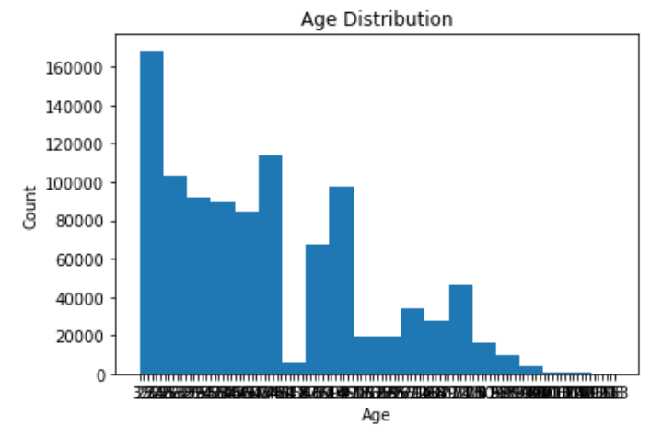
Most target customers are under 40 years old.

Slide 7
EDA
Correlation Matrix

Slide 8
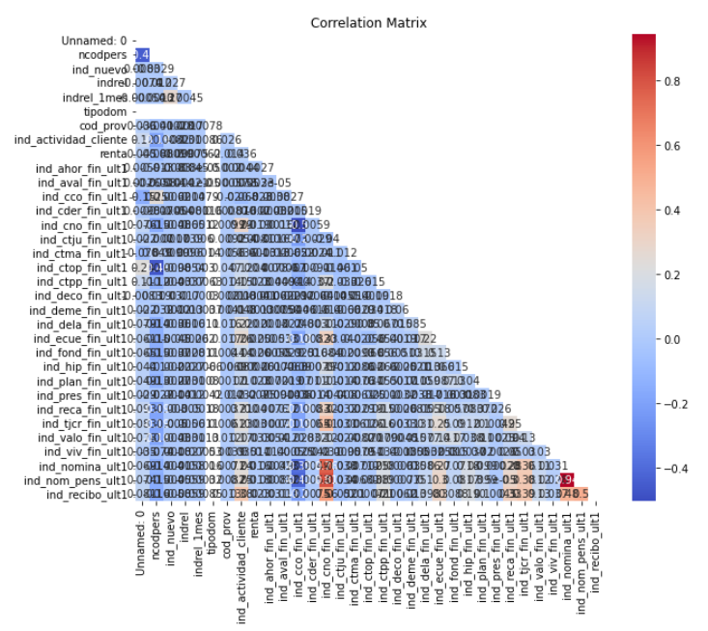
Most two variables in the dataset are not really correlated.

Slide 9
Final Recommendation
Based on the EDA performed, we can make the following recommendations for the company:
The dataset contains missing values, outliers and categorical variables that need to be preprocessed before analysis. The missing values can be filled with appropriate values such as mean, median or mode depending on the distribution of the data. Outliers can be removed or handled using appropriate techniques such as winsorization or transformations. Categorical variables can be encoded using one-hot encoding or label encoding techniques.
The distribution of the target variable (y) indicates that the dataset is imbalanced, with a higher proportion of negative outcomes than positive outcomes. This could potentially impact the model’s performance and should be considered during model training.
The correlation heatmap shows that some of the numerical variables are strongly correlated with each other, which may lead to multicollinearity issues during model training. Feature selection or dimensionality reduction techniques can be used to reduce the number of features and improve model performance.
The box plot of age distribution by gender shows that there are some outliers in the data. These outliers could potentially impact the model’s performance and should be handled accordingly.
The histogram of numerical variables shows that most of the variables have a skewed distribution. Transformations such as log, square root or box-cox transformations can be used to reduce the skewness and improve the model’s performance.
The scatter plot matrix shows that there is no strong correlation between the numerical variables and the target variable (y). This indicates that a simple linear regression model may not perform well on this dataset, and more complex models such as decision trees, random forests or neural networks may need to be explored.
Finally, it is recommended to use cross-validation techniques such as K-fold or stratified K-fold to evaluate the performance of the models on the imbalanced dataset. This will ensure that the model is able to generalize well on new unseen data.

Slide 10
Solution
Handling Missing Values:
Identify the columns with missing values and assess the extent of missingness.
For numerical variables, fill missing values with the mean, median, or another appropriate value based on the distribution of the data.
For categorical variables, fill missing values with the mode (most frequent value) or consider creating a new category for missing values.

Slide 11
Solution
Outlier Treatment:
Identify the variables with outliers, such as age in this case.
Decide on the appropriate treatment for outliers based on the nature of the data and the specific requirements of your analysis.
Remove outliers if they are genuine data entry errors or extreme values that are not representative of the population.
Alternatively, consider using techniques like winsorization to cap the extreme values or transformations such as logarithmic or Box-Cox transformation to reduce the impact of outliers.

Slide 12
Solution
Categorical Variable Encoding:
Identify the categorical variables that require encoding, such as "sexo" (gender) in this case.
For binary categorical variables, you can use label encoding (assigning 0 or 1) or create dummy variables.
For categorical variables with more than two categories, one-hot encoding or binary encoding can be used to represent each category as a separate binary feature.

Slide 13
Solution
Imbalanced Dataset:
Assess the distribution of the target variable (y) and confirm if it is imbalanced.
Consider using techniques to handle imbalanced data, such as oversampling the minority class, undersampling the majority class, or using algorithms specifically designed for imbalanced data (e.g., SMOTE).
Evaluate the model's performance using appropriate metrics that account for imbalanced data, such as precision, recall, F1-score, or area under the ROC curve (AUC-ROC).

Slide 14
Solution
Multicollinearity:
Analyze the correlation heatmap to identify strongly correlated numerical variables.
Determine if multicollinearity is present, which can affect model stability and interpretation.
Apply techniques like feature selection (e.g., using correlation or mutual information) or dimensionality reduction (e.g., principal component analysis, PCA) to reduce the number of correlated features while preserving important information.

Slide 15
Solution
Skewed Distributions:
Examine the histogram of numerical variables to identify skewed distributions.
Apply appropriate transformations like logarithmic, square root, or Box-Cox transformation to reduce skewness and make the distribution closer to normal.
Transformed variables can be used for analysis, or the transformation can be reversed during model evaluation or result interpretation.

Slide 16
Solution
Complex Model Selection:
Evaluate the scatter plot matrix to understand the relationship between numerical variables and the target variable.
If a simple linear regression model does not exhibit strong correlations, consider exploring more complex models such as decision trees, random forests, gradient boosting, or neural networks.
Experiment with different models and evaluate their performance using appropriate evaluation metrics, such as accuracy, precision, recall, F1-score, or area under the ROC curve (AUC-ROC).

Slide 17
Solution
Cross-Validation:
Due to the imbalanced nature of the dataset, use cross-validation techniques such as K-fold or stratified K-fold to evaluate model performance.
This ensures that the model is trained and evaluated on different subsets of data, providing a more robust estimate of its performance on unseen data.
Use appropriate evaluation metrics considering the imbalanced class distribution.

Slide 18
Thank You

